Slide 1
Hospitality & Tourism Management System
Project Number: 28
A.Hari Kailash (2200030370)
K.Jaya surya (2200032241)
Y.Bhargav Ram (2200031883)

Slide 2

A Hospitality and Tourism Management System is a software solution designed for the hospitality and tourism industry. It integrates reservation management, customer relationship management, point of sale, inventory, financial tracking, and reporting tools. This system streamlines operations, enhances guest experiences, and facilitates efficient resource management for hotels, resorts, travel agencies, and other businesses in the sector. It often includes features like mobile check-in, staff management, online marketing, and integration with tour services, contributing to improved efficiency and customer satisfaction.

Slide 3
1. Online Booking and Reservation:
User-friendly interfaces for guests to book rooms, flights, or tours.
Real-time availability updates and confirmation notifications.
2. Property Management System (PMS):
Automated check-in/check-out processes.
Room assignment, housekeeping coordination, and billing management.
3. Customer Relationship Management (CRM):
Guest profiles with preferences and history tracking.
Loyalty programs and personalized services management.
4. Tourism Management:
Itinerary planning and booking for tours and activities.
Integration with local attractions and tour operators.
5. Feedback and Reviews:
Surveys and feedback collection.
Integration with review platforms for reputation management.

Slide 4
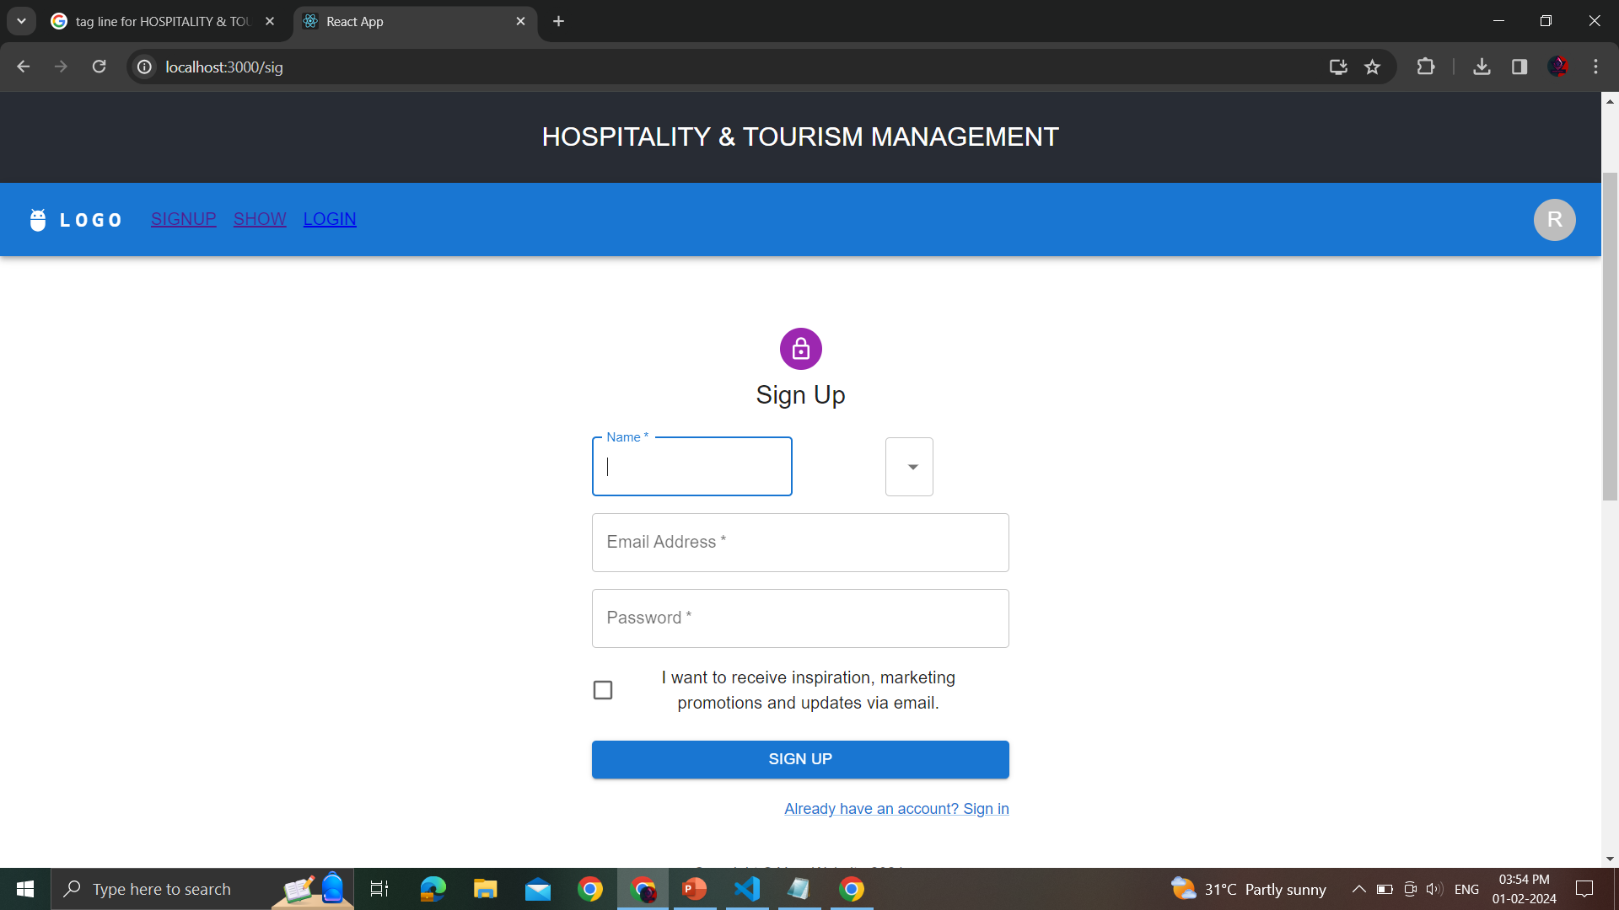

Slide 5
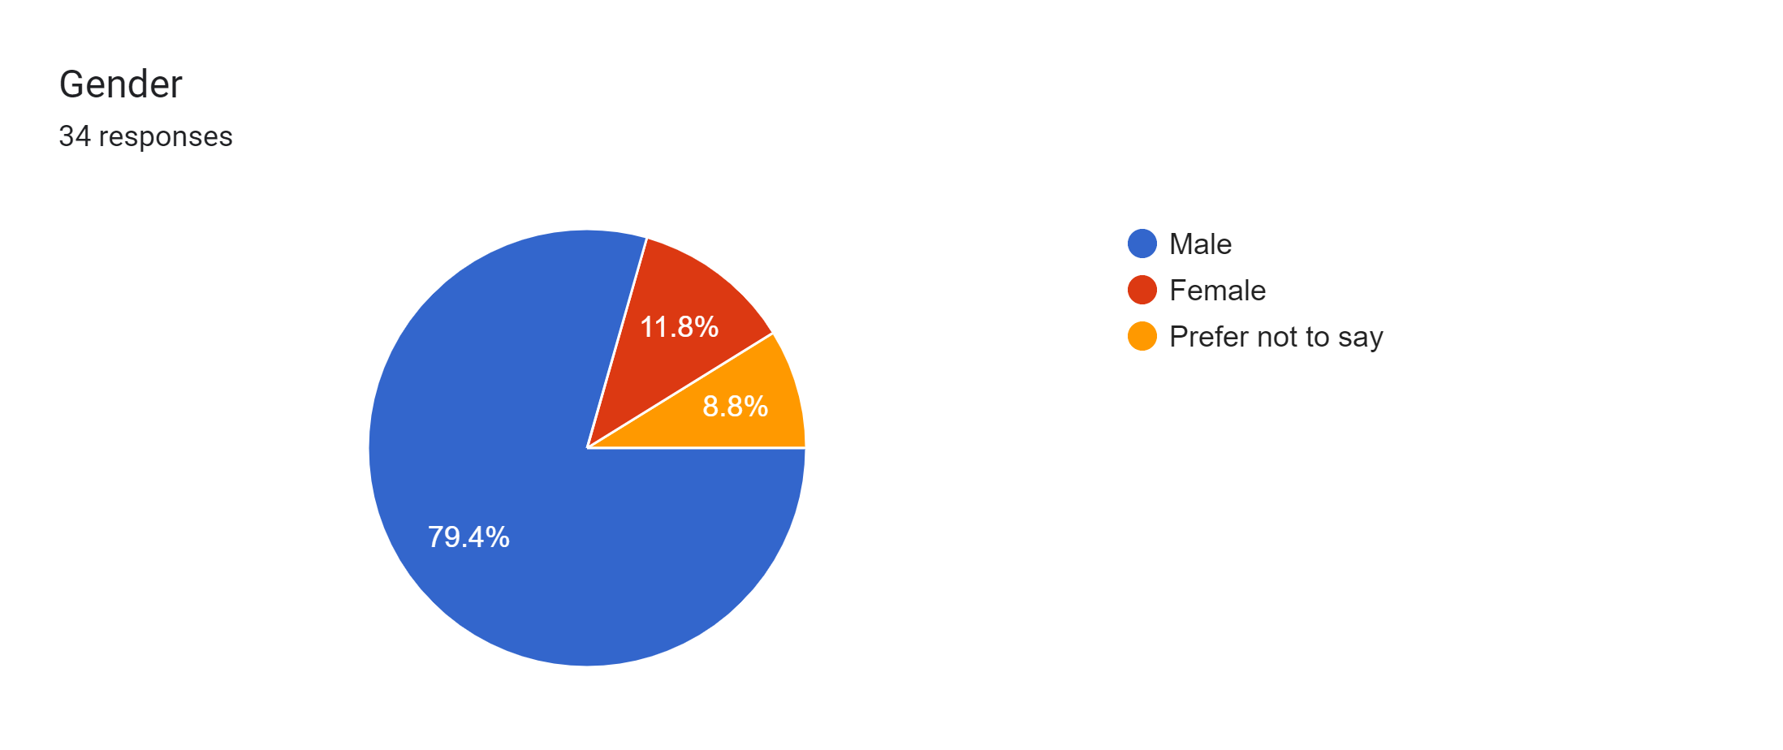
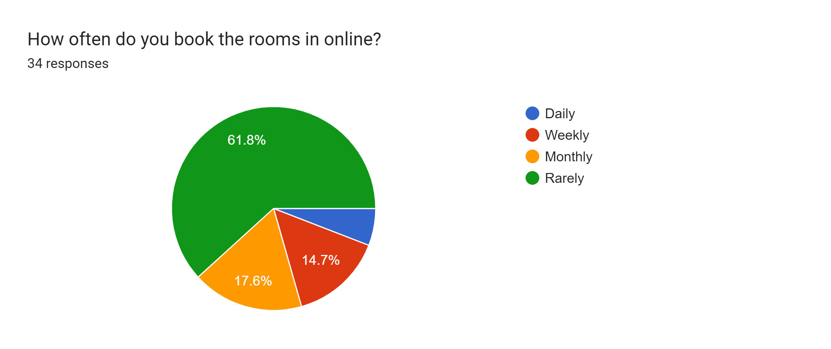
THE GATHERED INFORMATION FROM OUR SURVEY:
And this our form link: https://forms.gle/chhcfu4VZHDv9FBaA

